Slide 1
Geometrical proofs
LO: Use vector addition, subtraction and scalar multiples to deduce some geometrical results.

Slide 2
Using vectors to solve problems
We can use vectors to solve many problems involving physical quantities such as force and velocity.
We can also use vectors to prove geometric results.
For example, suppose we have a triangle ABC as follows:
The line PQ is such that P is the mid-point of AB and Q is the mid-point of AC.
B
P
Use vectors to show that PQ is parallel to BC and that the length of BC is double the length of PQ.
A
Q
C

Slide 3
Using vectors to solve problems
Let’s call vector a and vector b.
B
P
a
A
b
Q
C
Therefore,
We can conclude from this that PQ is parallel to BC and that the length of BC is double the length of PQ.
Notes:
Explain that to go from B to C we can go from B to A and then from A to C. This is equivalent to –2a + 2b.
Remind pupils that when one vector is a scalar multiple of another we can conclude that the two vectors are parallel.

Slide 4
Using vectors to solve problems
In triangle OXY, A, B and C are the mid points of OX, OY and XY respectively.
$$\vec{OX}=x$$
and
$$\vec{OY}=y$$
(a) Find expressions for $\vec{OA},\vec{OB}$, $\vec{XY},\vec{OC} and \vec{CO}$in terms of x and y
$$\frac{1}{2}\vec{OX}$$
$$= \frac{1}{2}x$$
$$\vec{OA}=$$
X
$$= \frac{1}{2}y$$
$$\vec{OB}=$$
$$\frac{1}{2}\vec{OY}$$
x
A
C
$$\vec{XY}=$$
$$\vec{XO}+\vec{OY}$$
$$=−x+y$$
$$=y−x$$
O
B
Y
$$=\vec{OX}+\frac{1}{2}\vec{XY}$$
y
$$\vec{OC}=$$
$$\vec{OX}+\vec{XC}$$
$$=x+\frac{1}{2}\left(y−x\right)$$
$$=\frac{1}{2}x+\frac{1}{2}y$$
$$=\frac{1}{2}\left(x+y\right)$$
$$=−\frac{1}{2}\left(x+y\right)$$
$$\vec{CO}=$$
$$−\vec{OC}$$

Slide 5
Using vectors to solve problems
In triangle OXY, A, B and C are the mid points of OX, OY and XY respectively.
$$\vec{OX}=x$$
and
$$\vec{OY}=y$$
(b) Find an expression for $\vec{AB}$in terms of x and y
$$=−\frac{1}{2}x+\frac{1}{2}y$$
$$\vec{AB}=$$
$$\vec{AO}+\vec{OB}$$
X
$$=\frac{1}{2}\left(y−x\right)$$
x
A
C
(c) What is the relationship between the line XY and the line AB?
O
B
y
Y
$$\frac{1}{2}\left(y−x\right)$$
$$\vec{XY}=$$
$$y−x$$
$$\vec{AB}=$$
Then the line XY is double the length of the line AB and the same direction as AB
Therefore the line XY is parallel to the line AB

Slide 6
Using vectors to solve problems
In triangle OXY, A, B and C are the mid points of OX, OY and XY respectively.
$$\vec{OX}=x$$
and
$$\vec{OY}=y$$
(d) P is a point such that $\vec{OP}=\vec{OX}+$ $\frac{2}{3}\vec{XB}$. Find $\vec{OP}$
$$+ \frac{2}{3}\vec{XB}$$
$$\vec{OP}=$$
$$\vec{OX}$$
X
$$\vec{OP}=$$
$$+ \frac{2}{3}\left(\vec{XO}+\vec{OB}\right)$$
x
$$x$$
A
C
$$+\frac{2}{3}\left(−x+\frac{1}{2}y\right)$$
$$\vec{OP}=$$
$$x$$
O
B
y
Y
$$=\frac{1}{3}x+\frac{1}{3}y$$
$$=\frac{1}{3}\left(x+y\right)$$
$=x−\frac{2}{3}x$ $+\frac{1}{3}y$
$$\frac{1}{3}\left(x+y\right)$$
$$\vec{OP}=$$

Slide 7
Using vectors to solve problems
In triangle OXY, A, B and C are the mid points of OX, OY and XY respectively.
$$\vec{OX}=x$$
and
$$\vec{OY}=y$$
(e) What you can conclude about the position of P?
$$+ \frac{2}{3}\vec{XB}$$
$$\vec{OP}=$$
$$\vec{OX}$$
X
$$\vec{OP}=$$
$$+ \frac{2}{3}\left(\vec{XO}+\vec{OB}\right)$$
x
$$x$$
A
C
$$+\frac{2}{3}\left(−x+\frac{1}{2}y\right)$$
$$\vec{OP}=$$
$$x$$
O
B
y
Y
$$=\frac{1}{3}x+\frac{1}{3}y$$
$$=\frac{1}{3}\left(x+y\right)$$
$=x−\frac{2}{3}x$ $+\frac{1}{3}y$
$$\frac{1}{3}\left(x+y\right)$$
$$\vec{OP}=$$

Slide 8
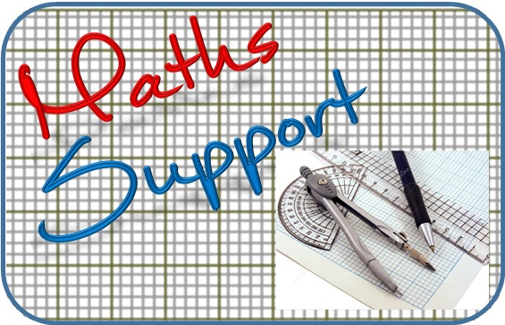
Thank you for using resources from
For more resources visit our website
https://www.mathssupport.org
If you have a special request, drop us an email
info@mathssupport.org

