Slide 1
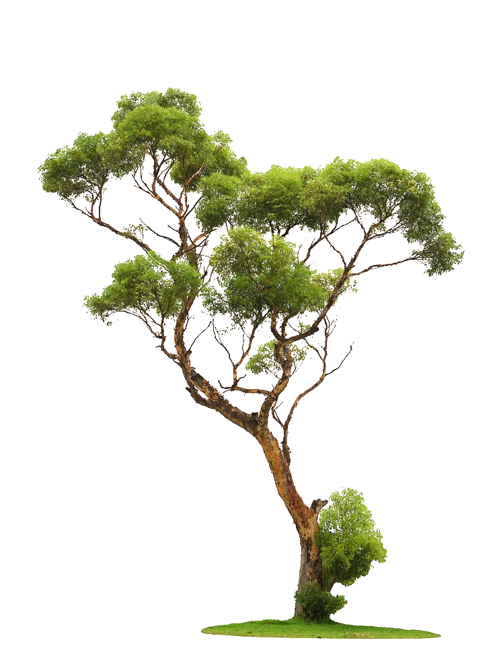
Probability tree diagrams
LO: Use tree diagrams to represent information and calculate probabilities.

Slide 2
Tree diagrams
We can use a tree diagram to illustrate sample spaces provided that the alternatives are not too numerous.
The advantage of tree diagrams is that they can be used when more than one event is involved.
Once the sample space is illustrated, the tree diagram can be used for determining probabilities.
Example 1:
Peter tosses two coins. Draw a tree diagram to show all possible outcomes.
The probabilities of Head (H) and Tail (T) are marked on the branches.
First Coin
Second Coin
Outcome
Probability
$$\frac{1}{2}$$
H
H, H
$$\frac{1}{2}$$
×
$$\frac{1}{2}$$
=
$$\frac{1}{4}$$
There are four alternatives and each branch shows a particular outcome
H
$$\frac{1}{2}$$
H, T
$$\frac{1}{2}$$
×
$$\frac{1}{2}$$
=
$$\frac{1}{4}$$
$$\frac{1}{2}$$
T
$$\frac{1}{2}$$
H
T, H
$$\frac{1}{2}$$
×
$$\frac{1}{2}$$
=
$$\frac{1}{4}$$
$$\frac{1}{2}$$
All outcomes are represented and the probabilities are obtained by multiplying
T
$$\frac{1}{2}$$
T
T, T
$$\frac{1}{2}$$
×
$$\frac{1}{2}$$
=
$$\frac{1}{4}$$

Slide 3
Tree diagrams
Example 2:
Bill and Andrea are members of the school archery club. The probability that Bill hits the target is $\frac{4}{5}$.
The probability that Andrea hits the target is $\frac{5}{6}$ .
They both shoot simultaneously.
Draw a tree diagram to show all possible outcomes.
Bill’s results
Andrea’s results
Outcome
Probability
H = Hit
$$\frac{5}{6}$$
H
H, H
$$\frac{4}{5}$$
×
$$\frac{5}{6}$$
=
$$\frac{20}{30}$$
M = Miss
H
$$\frac{1}{6}$$
H, M
$$\frac{4}{5}$$
×
$$\frac{1}{6}$$
=
$$\frac{4}{30}$$
$$\frac{4}{5}$$
M
$$\frac{5}{6}$$
H
M, H
$$\frac{1}{5}$$
×
$$\frac{5}{6}$$
=
$$\frac{5}{30}$$
$$\frac{1}{5}$$
M
$$\frac{1}{6}$$
M
M, M
$$\frac{1}{5}$$
×
$$\frac{1}{6}$$
=
$$\frac{1}{30}$$
What is the probability that they both hit the target?
$$\frac{20}{30}$$
P(H, H) =

Slide 4
Tree diagrams
Example 2:
Bill and Andrea are members of the school archery club. The probability that Bill hits the target is $\frac{4}{5}$.
The probability that Andrea hits the target is $\frac{5}{6}$ .
They both shoot simultaneously.
Draw a tree diagram to show all possible outcomes.
Bill’s results
Andrea’s results
Outcome
Probability
H = Hit
$$\frac{5}{6}$$
H
H, H
$$\frac{4}{5}$$
×
$$\frac{5}{6}$$
=
$$\frac{20}{30}$$
M = Miss
H
$$\frac{1}{6}$$
H, M
$$\frac{4}{5}$$
×
$$\frac{1}{6}$$
=
$$\frac{4}{30}$$
$$\frac{4}{5}$$
M
$$\frac{5}{6}$$
H
M, H
$$\frac{1}{5}$$
×
$$\frac{5}{6}$$
=
$$\frac{5}{30}$$
$$\frac{1}{5}$$
M
$$\frac{1}{6}$$
M
M, M
$$\frac{1}{5}$$
×
$$\frac{1}{6}$$
=
$$\frac{1}{30}$$
What is the probability that they both miss the target?
$$\frac{1}{30}$$
P(M, M) =

Slide 5
Thank you for using resources from
For more resources visit our website
https://www.mathssupport.org
If you have a special request, drop us an email
info@mathssupport.org
Get 20% off in your next purchase from our website, just use this code when checkout: MSUPPORT_20

