Slide 1
Laws of indices for fractional exponents
LO: To understand and use the Laws of indices for rational exponents.

Slide 2


Fractional exponents
The exponents that you have used so far have been integers, either positive or negative.
However, exponents can also be fractions.
Example.
$$\frac{1}{4}$$
$$16$$
What is ?
To understand the meaning of fractional exponents let’s look at the following examples.

Slide 3
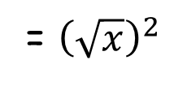





Fractional exponents
If we multiply the following powers we can see an interesting result.
Simplify:
$$\frac{1}{2}$$
$$\frac{1}{2}$$
If we use this rule
a^{m} ⨯ a^{n} =
a^{(m + n)}
x ⨯ x
$$\frac{1}{2}$$
$$\frac{1}{2}$$
$$\frac{1}{2}$$
$$+ \frac{1}{2}$$
= x¹
= x
x ⨯ x =
x
⨯
However, we know that
$\sqrt{x} \sqrt{x}$
= ${\left(\sqrt{x}\right)}^{2}$
= x
So, we conclude that
x =
$\sqrt{x}$
$$\frac{1}{2}$$
Similarly:
$$\frac{1}{3}$$
$$\frac{1}{3}$$
$$\frac{1}{3}$$
= a
a ⨯ a ⨯ a
and
$\sqrt[3]{a} \sqrt[3]{a} \sqrt[3]{a}$
= a
⨯
⨯
And so
a =
$\sqrt[3]{a}$
$$\frac{1}{3}$$
Notes:
Stress that the indices can only be added when the base is the same.

Slide 4



Fractional exponents
From the previous examples we can conclude.
If we raise a number to a fractional power is the same as the nth root of the number
$$\frac{1}{n}$$
$$\frac{1}{n}$$
$\sqrt[n]{a}$
= a
Notes:
Stress that the indices can only be added when the base is the same.

Slide 5
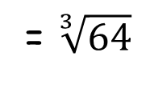
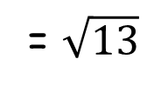
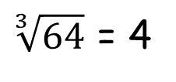
Fractional exponents
Example.
Write in radical form:
$$\frac{1}{2}$$
13
$$\frac{1}{2}$$
= $\sqrt{13}$
13
Example.
Find the value of
$$\frac{1}{3}$$
64
$$\frac{1}{3}$$
= $\sqrt[3]{64}$
64
$\sqrt[3]{64}$ = 4
Notes:
Stress that the indices can only be added when the base is the same.

Slide 6
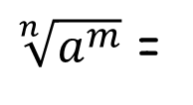


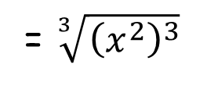

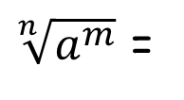





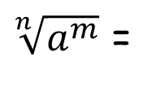
Roots
Simplify:
$$\sqrt[3]{x^{6}}$$
Since
x⁶ =
x² × x² × x²
$$\sqrt[3]{x^{6}}$$
$$\sqrt[3]{x^{2} x^{2} x^{2}}$$
= $\sqrt[3]{{\left(x^{2}\right)}^{3}}$
=
×
×
$$\sqrt[3]{x^{6}}$$
= x²
$$\frac{6}{3}$$
= x
Simplify:
$$\sqrt[n]{a^{m}}$$
Since
$\sqrt[n]{a^{m}}$ =
$${\left(\sqrt[n]{a}\right)}^{m}$$
$\sqrt[n]{a^{m}}$ =
$${\left(a \right)}^{m}$$
$$\frac{1}{n}$$
$\sqrt[n]{a^{m}}$ =
$$a$$
$$\frac{m}{n}$$

Slide 7
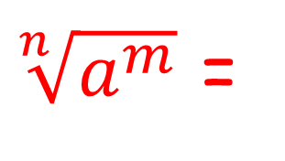


Roots
Any root can be written as a fractional power.
$\sqrt[n]{a^{m}}$ =
$$a$$
$$\frac{m}{n}$$

Slide 8


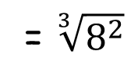
Fractional exponents
Example.
Write in exponent form:
$\sqrt[4]{x^{3}}$
$$\sqrt[4]{x^{3}}$$
$$\frac{3}{4}$$
= x
Example.
Find the value of
$$\frac{2}{3}$$
8
$$\frac{2}{3}$$
= $\sqrt[3]{8^{2}}$
8
$\sqrt[3]{64}$ = 4
Notes:
Stress that the indices can only be added when the base is the same.

Slide 9

Thank you for using resources from
For more resources visit our website
https://www.mathssupport.org
If you have a special request, drop us an email
info@mathssupport.org

