Slide 1
Transforming reciprocal functions
LO: Identify the changes on a reciprocal function after a transformation.

Slide 2

Transforming functions
Graphs can be transformed by translating, reflecting, stretching or rotating them.
In this lesson we are going to consider only Translations and stretches.
The equation of the transformed graph will be related to the equation of the original graph.
When investigating transformations it is most useful to express functions using function notation.
For example, suppose we wish to investigate transformations of the function f(x) = $\frac{1}{x}.$
The equation of the graph of y = $\frac{1}{x}$, can be written as y = f(x).

Slide 3
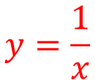
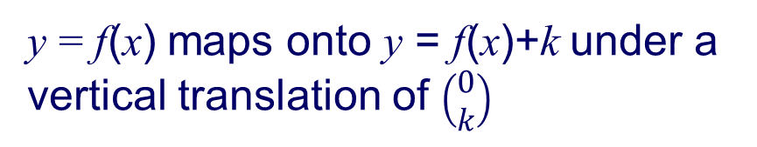
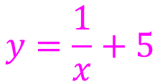
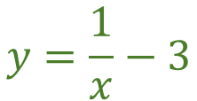
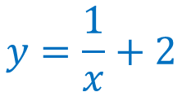
Transforming functions
y
8
7
Sketch the graph of:
6
f (x) + 5
$$y=\frac{1}{x}$$
5
= f (x)
4
3
f (x) + 2
Sketch the graph of:
2
$$y=\frac{1}{x}+2$$
f (x)
= f (x) +2
1
1 2 3 4 5 6 7
Sketch the graph of:
–7 –6 –5 –4 –3 –2 –1
x
⁻1
$$y=\frac{1}{x}−3$$
⁻2
f (x) - 3
= f (x) -3
⁻3
Sketch the graph of:
⁻4
⁻5
$$y=\frac{1}{x}+5$$
= f (x) +5
⁻6
y = f(x) maps onto y = f(x)+k under a vertical translation of $\left(\begin{matrix}0 \\ k\end{matrix}\right)$

Slide 4

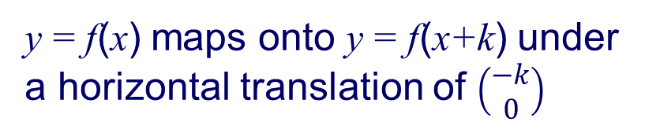
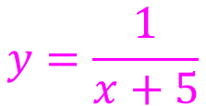
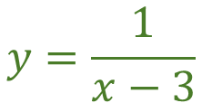
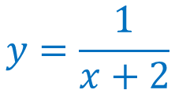
Transforming functions
y
8
7
Sketch the graph of:
6
$$y=\frac{1}{x}$$
5
= f (x)
4
Sketch the graph of:
f (x+5)
f (x+2)
3
f (x)
f (x-3)
2
$$y=\frac{1}{x+2}$$
= f (x+2)
1
1 2 3 4 5 6 7
Sketch the graph of:
–7 –6 –5 –4 –3 –2 –1
x
⁻1
$$y=\frac{1}{x−3}$$
⁻2
= f (x-3)
⁻3
Sketch the graph of:
⁻4
⁻5
$$y=\frac{1}{x+5}$$
= f (x+5)
⁻6
y = f(x) maps onto y = f(x+k) under a horizontal translation of $\left(\begin{matrix}−k \\ 0\end{matrix}\right)$

Slide 5
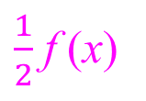
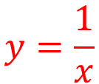
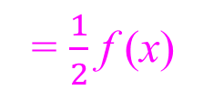
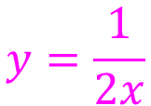
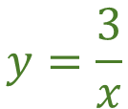
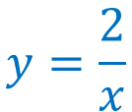
Transforming functions
y
8
7
Sketch the graph of:
6
$$y=\frac{1}{x}$$
5
= f (x)
4
Sketch the graph of:
3
2f (x)
$$y=\frac{2}{x}$$
2
f (x)
=2 f (x)
3f (x)
1
Sketch the graph of:
1 2 3 4 5 6 7
–7 –6 –5 –4 –3 –2 –1
$\frac{1}{2}$ f (x)
x
⁻1
$$y=\frac{3}{x}$$
= 3f (x)
⁻2
Sketch the graph of:
⁻3
⁻4
$$y=\frac{1}{2x}$$
= $\frac{1}{2}$ f (x)
⁻5
⁻6
y = f(x) maps onto y = kf(x) under a stretch with invariant x-axis and scale factor k

Slide 6
Summarising.
Vertical translation
y = f(x) maps onto y = f(x)+k under a vertical translation of $\left(\begin{matrix}0 \\ k\end{matrix}\right)$
f (x) + k translates f (x) vertically a distance of k units upward
f (x) – k translates f (x) vertically a distance of k units downward
Horizontal translation
y = f(x) maps onto y = f(x+k) under a horizontal translation of $\left(\begin{matrix}−k \\ 0\end{matrix}\right)$
f (x + k) translates f (x) horizontally k units to the left
f (x – k ) translates f (x) horizontally k units to the right.
Stretch
kf (x) stretches f (x) vertically with invariant x-axis and scale factor k

Slide 7

Thank you for using resources from
For more resources visit our website
https://www.mathssupport.org
If you have a special request, drop us an email
info@mathssupport.org

