Slide 1
Solving simultaneous equations using GDC

Slide 2
Solving simultaneous equations using the GDC
We are going to see hot to use the GDC to solve simultaneous equations.
Make sure that the equations are in order
Use the GDC to solve
2x - 3y = 4
3x + 2y = 19
We are going to use Graphing display calculator to solve the Simultaneous equations using the Equation solver
CASIO
Texas Instruments

Slide 3
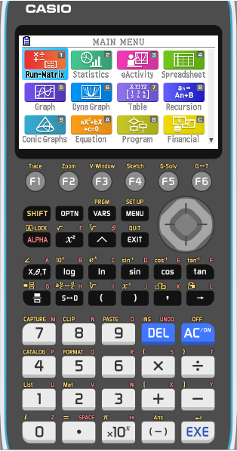
Solving simultaneous equations using the GDC
Use your GDC to solve these simultaneous equations.
2x - 3y = 4
3x + 2y = 19
Select EQUATION from the main MENU

Slide 4
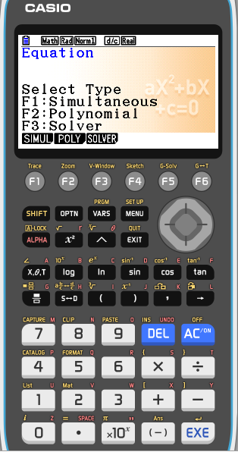
Solving simultaneous equations using the GDC
Use your GDC to solve these simultaneous equations.
2x - 3y = 4
3x + 2y = 19
Select EQUATION from the main MENU
Then press F1 (SIMUL)

Slide 5
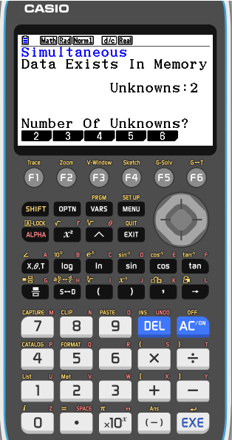
Solving simultaneous equations using the GDC
Use your GDC to solve these simultaneous equations.
2x - 3y = 4
3x + 2y = 19
Select EQUATION from the main MENU
Then press F1 (SIML)
We have two unknowns in our equations so, press F1 (2)

Slide 6
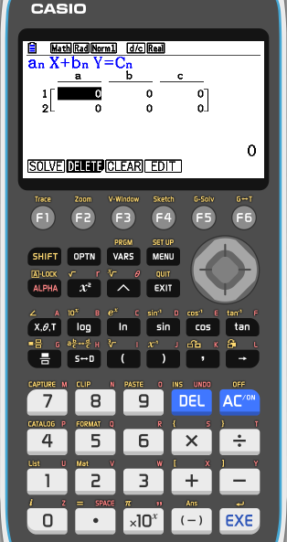
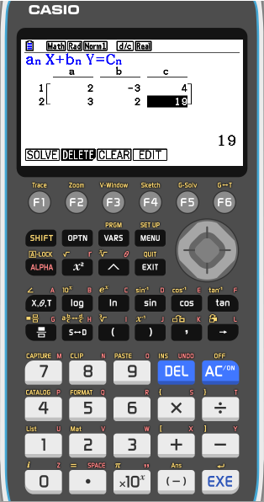
Solving simultaneous equations using the GDC
Use your GDC to solve these simultaneous equations.
2x - 3y = 4
3x + 2y = 19
Select EQUATION from the main MENU
Then press F1 (SIML)
We have two unknowns in our equations so, press F1 (2)
Enter the coefficients of the equations as shown, pressing EXE after each entry.
Press F1 (SOLV) to solve the system

Slide 7
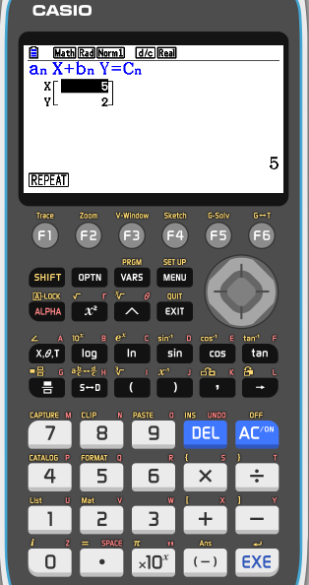
Solving simultaneous equations using the GDC
Use your GDC to solve these simultaneous equations.
2x - 3y = 4
3x + 2y = 19
Select EQUATION from the main MENU
Then press F1 (SIML)
We have two unknowns in our equations so, press F1 (2)
Enter the coefficients of the equations as shown, pressing EXE after each entry.
x = 5
y = 2

Slide 8
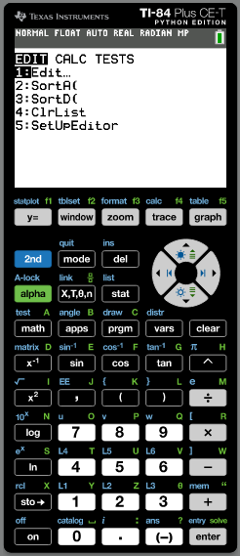
Solving simultaneous equations using the GDC
Use your GDC to solve these simultaneous equations.
2x - 3y = 4
3x + 2y = 19
Press the key APPS

Slide 9
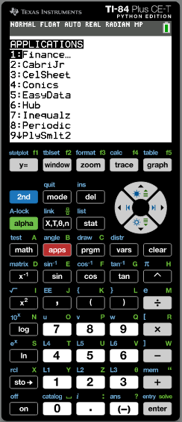
Solving simultaneous equations using the GDC
Use your GDC to solve these simultaneous equations.
2x - 3y = 4
3x + 2y = 19
Press the key APPS
Then press 9 (PlySmlt2)

Slide 10
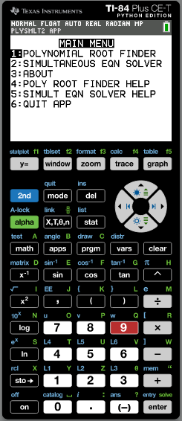
Solving simultaneous equations using the GDC
Use your GDC to solve these simultaneous equations.
2x - 3y = 4
3x + 2y = 19
Press the key APPS
Then press 9 (PlySmlt2)
Press 2 (SIMULTANEOUS EQN SOLVER)

Slide 11
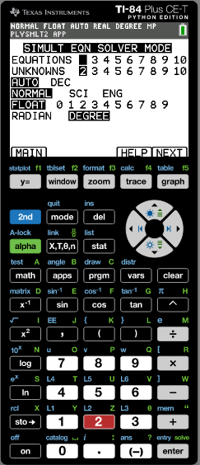
Solving simultaneous equations using the GDC
Use your GDC to solve these simultaneous equations.
2x - 3y = 4
3x + 2y = 19
Press the key APPS
Then press 9 (PlySmlt2)
Press 2 (SIMULTANEOUS EQN SOLVER)
We have two equations and two unknowns in our so, press F5 (NEXT)

Slide 12
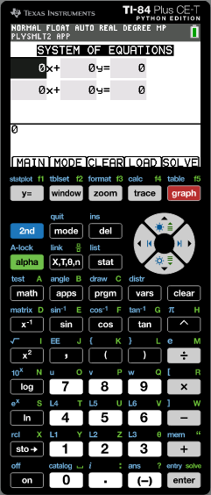
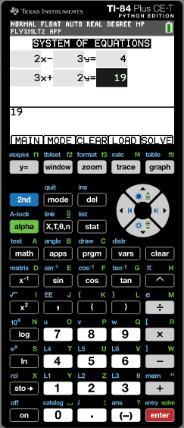
Solving simultaneous equations using the GDC
Use your GDC to solve these simultaneous equations.
2x - 3y = 4
3x + 2y = 19
Press the key APPS
Then press 9 (PlySmlt2)
Press 2 (SIMULTANEOUS EQN SOLVER)
We have two equations and two unknowns in our so, press F5 (NEXT)
Enter the coefficients of the equations as shown, pressing ENTER after each entry.
Press F5 (SOLVE) to solve the system

Slide 13
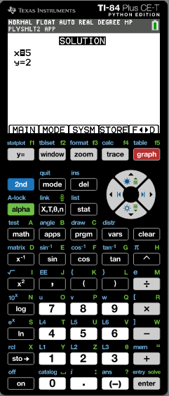
Solving simultaneous equations using the GDC
Use your GDC to solve these simultaneous equations.
2x - 3y = 4
3x + 2y = 19
Press the key APPS
Then press 9 (PlySmlt2)
Press 2 (SIMULTANEOUS EQN SOLVER)
We have two equations and two unknowns in our so, press F5 (NEXT)
Enter the coefficients of the equations as shown, pressing ENTER after each entry.
x = 5
y = 2

Slide 14
Solving simultaneous equations using the GDC
We can also solve linear simultaneous equations by graphing each of the equations.
The coordinates of the intersection point give us the solution to the equations
Use graphical method to solve
y = 3x - 2
2x + y = 13
When using graphics calculator, you must first rearrange the equations so that y is the subject
y = 3x - 2
y = -2x + 13
We are going to use Graphing display calculator to solve the Simultaneous equations using the Graphs
CASIO
Texas Instruments

Slide 15
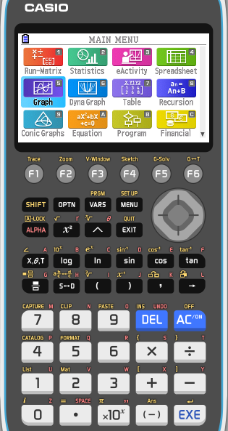
Solving simultaneous equations using the GDC
y = 3x - 2
y = -2x + 13
Select GRAPH from the main MENU

Slide 16
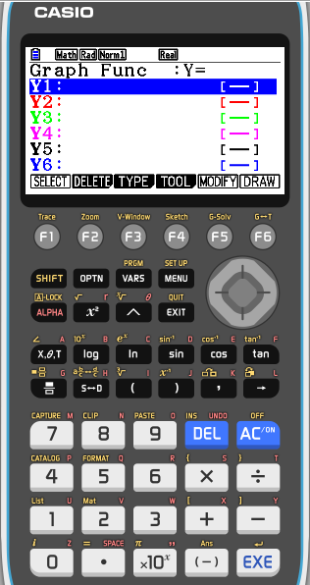
Solving simultaneous equations using the GDC
y = 3x - 2
y = -2x + 13
Select GRAPH from the main MENU
Type 3x - 2 into Y1 and
-2x + 13 into Y2.

Slide 17
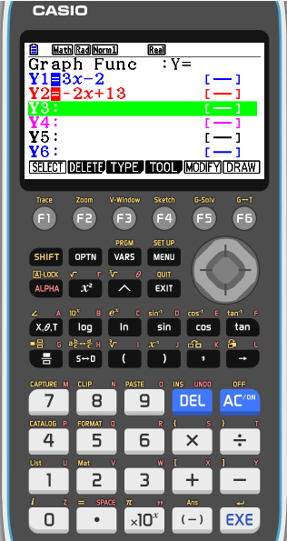
Solving simultaneous equations using the GDC
y = 3x - 2
y = -2x + 13
Select GRAPH from the main MENU
Type 3x - 2 into Y1 and
-2x + 13 into Y2.
Press F6 (DRAW) to draw a graph of the functions

Slide 18
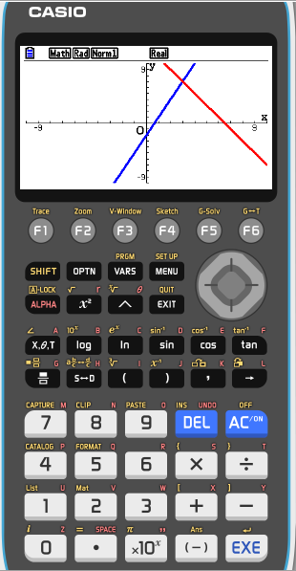
Solving simultaneous equations using the GDC
y = 3x - 2
y = -2x + 13
Select GRAPH from the main MENU
Type 3x - 2 into Y1 and
-2x + 13 into Y2.
Press F6 (DRAW) to draw a graph of the functions
To find their point of intersection, press F5 (G-Solv)
F5 (ISCT).

Slide 19
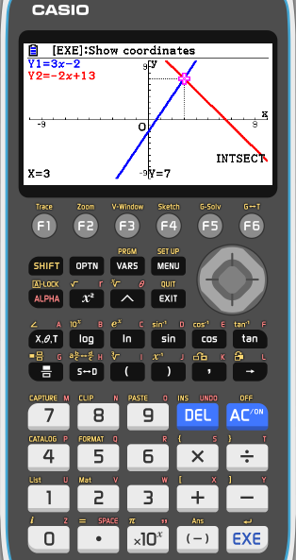
Solving simultaneous equations using the GDC
y = 3x - 2
y = -2x + 13
Select GRAPH from the main MENU
Store 3x - 2 into Y1 and
-2x + 13 into Y2.
Press F6 (DRAW) to draw a graph of the functions
To find their point of intersection, press F5 (G-Solv)
F5 (ISCT).
So, the solution is x = 3, y = 7.

Slide 20
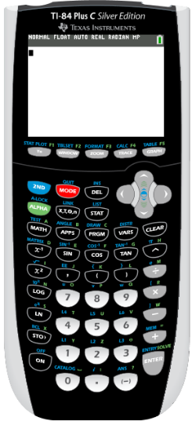
Solving simultaneous equations using the GDC
y = 3x - 2
y = -2x + 13
Click on Y =

Slide 21
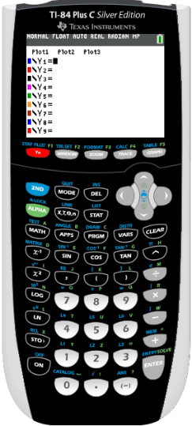
Solving simultaneous equations using the GDC
y = 3x - 2
y = -2x + 13
Click on Y =
Type 3x - 2 into Y1 and
-2x + 13 into Y2.

Slide 22
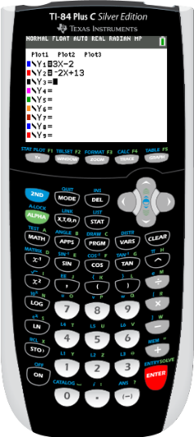
Solving simultaneous equations using the GDC
y = 3x - 2
y = -2x + 13
Click on Y =
Type 3x - 2 into Y1 and
-2x + 13 into Y2.
Press DRAW to draw a graph of the functions

Slide 23
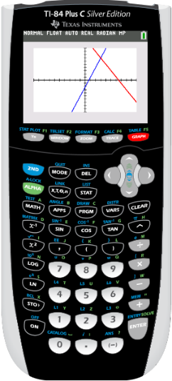
Solving simultaneous equations using the GDC
y = 3x - 2
y = -2x + 13
Click on Y =
Type 3x - 2 into Y1 and
-2x + 13 into Y2.
Press DRAW to draw a graph of the functions
Press 2nd
CALC

Slide 24
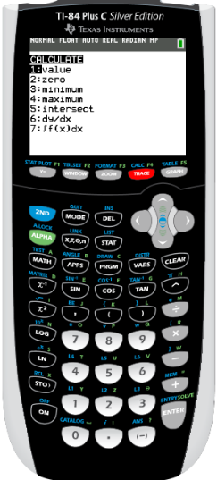
Solving simultaneous equations using the GDC
y = 3x - 2
y = -2x + 13
Click on Y =
Type 3x - 2 into Y1 and
-2x + 13 into Y2.
Press DRAW to draw a graph of the functions
Press 2nd
CALC
Press 5 (intersect).

Slide 25
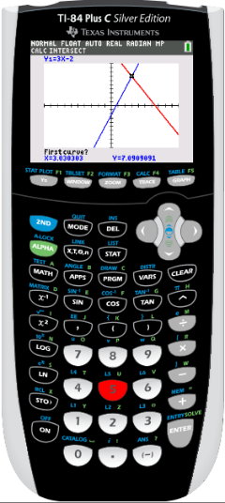
Solving simultaneous equations using the GDC
y = 3x - 2
y = -2x + 13
Click on Y =
Type 3x - 2 into Y1 and
-2x + 13 into Y2.
Press DRAW to draw a graph of the functions
Press 2nd
CALC
Press 5 (intersect).
Select the first graph
ENTER

Slide 26
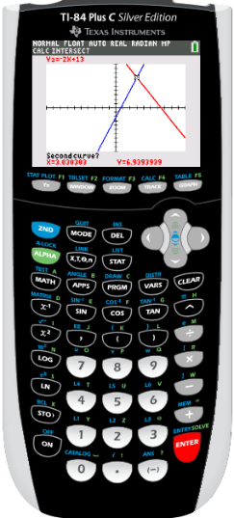
Solving simultaneous equations using the GDC
y = 3x - 2
y = -2x + 13
Click on Y =
Type 3x - 2 into Y1 and
-2x + 13 into Y2.
Press DRAW to draw a graph of the functions
Press 2nd
CALC
Press 5 (intersect).
Select the first graph
ENTER
Select the second graph
ENTER

Slide 27
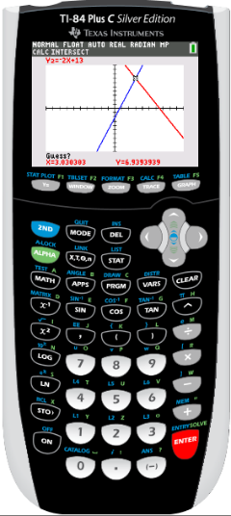
Solving simultaneous equations using the GDC
y = 3x - 2
y = -2x + 13
Click on Y =
Type 3x - 2 into Y1 and
-2x + 13 into Y2.
Press DRAW to draw a graph of the functions
Press 2nd
CALC
Press 5 (intersect).
Select the first graph
ENTER
Select the second graph
ENTER
Guess a value
ENTER

Slide 28
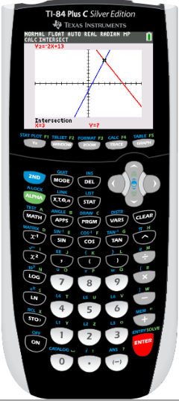
Solving simultaneous equations using the GDC
y = 3x - 2
y = -2x + 13
Click on Y =
Type 3x - 2 into Y1 and
-2x + 13 into Y2.
Press DRAW to draw a graph of the functions
Press 2nd
CALC
Press 5 (intersect).
Select the first graph
ENTER
Select the second graph
ENTER
Guess a value
ENTER
So, the solution is x = 3, y = 7.

Slide 29
Thank you for using resources from
For more resources visit our website
https://www.mathssupport.org
If you have a special request, drop us an email
info@mathssupport.org
Get 20% off in your next purchase from our website, just use this code when checkout: MSUPPORT_20

