Slide 1
Power equations
LO: To solve power equations.

Slide 2
Power Equations
Power equations are equations involving powers with ‘unknowns’ as the base.
For example x³ = 27
x = 3

Slide 3
Power Equations
More generally,
if x^{n} = k, where n ∈ ℤ⁺, and n > 2, then.
If n is odd and x^{n} = k, then x = $\sqrt[n]{k}$
If n is even and x^{n} = k, where k > 0, then x = $±\sqrt[n]{k}$

Slide 4
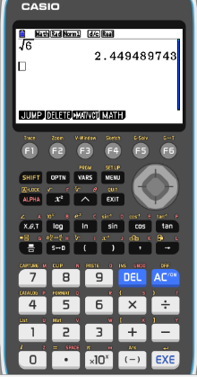
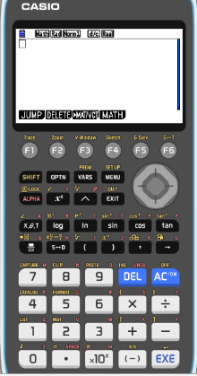
Solve by equating exponents
Use your calculator to solve for x, giving your answer to 3 sf:
x² = 6
$\sqrt{x^{2}}$ =
$$\sqrt{6}$$
x =
$$±\sqrt{6}$$
x ≈ ±2.45

Slide 5
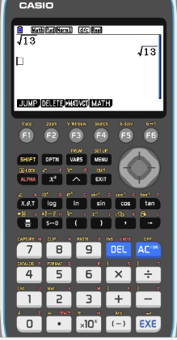
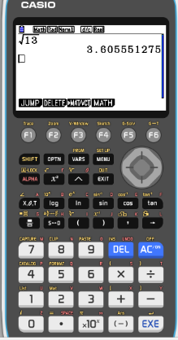
Solve by equating exponents
Use your calculator to solve for x, giving your answer to 3 sf:
x² = 13, x > 0
x =
$$\sqrt{13}$$
x ≈ 3.61

Slide 6
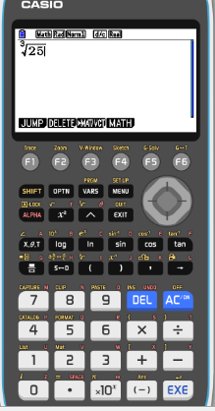
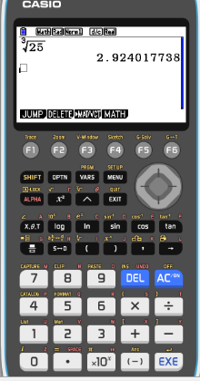
Solve by equating exponents
Use your calculator to solve for x, giving your answer to 3 sf:
x³ = 25
x =
$$\sqrt[3]{25}$$
x ≈ 2.92

Slide 7
Solve by equating exponents
Solve this equation giving the exact answer
$\frac{x}{3}$ = $\frac{7}{x}$
$\frac{(3x)x}{3}$ = $\frac{(3x)7}{x}$
Multiply both side by LCM of 3 and x
Simplifying
x² =
$$21$$
$\sqrt{x^{2}}$ =
$$\sqrt{21}$$
x =
$$±\sqrt{21}$$

Slide 8
Thank you for using resources from
For more resources visit our website
https://www.mathssupport.org
If you have a special request, drop us an email
info@mathssupport.org
Get 20% off in your next purchase from our website, just use this code when checkout: MSUPPORT_20

