Slide 1
Axes intercepts
LO: To be able to identify the axes intercepts in quadratic functions

Slide 2
Axes intercepts
y
An x-intercept of a function is a value of x where its graph meets the x-axis.
x-intercepts can be found by letting y be 0 in the equation of the function.
The x-intercepts
x
A y-intercept of a function is a value of y where its graph meets the y-axis.
y-intercepts can be found by letting x be 0 in the equation of the function.
The y-intercept

Slide 3
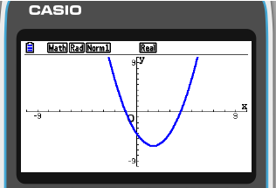
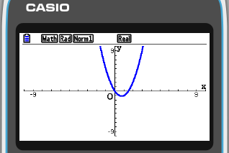
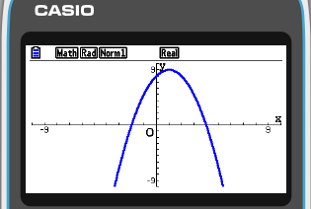
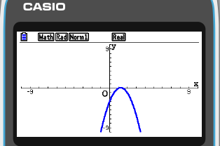
Use your GDC to sketch the following graphs:
y = x² – 3x – 4
y = 2x² – 3x
y-intercept
y-intercept
(0, -4)
(0, 0)
x-intercepts
x-intercepts
(-1, 0)
(4, 0)
(0, 0)
(1.5, 0)
Factorise the expression
Factorise the expression
(x – 4)
(x + 1)
x
(2x – 3)
y = – x² + 2x + 8
y = – 2x² + 5x – 3
y-intercept
y-intercept
(0, 8)
(0, -3)
x-intercepts
x-intercepts
(-2, 0)
(4, 0)
(1, 0)
(1.5, 0)
Factorise the expression
Factorise the expression
(x – 4)
(x + 2)
–(2x – 3)
(x – 1)

Slide 4
Axes intercepts
From this we may conclude:
If we have a quadratic function
f (x) = ax² + bx + c.
y
The y-intercept is (0, c).
(0, c)
If we factorise the expression, we have
(p, 0)
a(x – p)
(x – q)
f (x) =
(q, 0)
x
The x-intercepts are
(p, 0)
(q, 0)
The value of c is:
a(– p) (– q)

Slide 5
Axes intercepts
For this quadratic graph:
We have the quadratic function
f (x) = ax² + bx + c.
y
The y-intercept is (0, c).
(0, c)
If we factorise the expression, we have
(w, 0)
f (x) =
a(x – w)²
x
The x-intercepts is
(w, 0)
There is only one x-intercept, which means the graph just touches the x-axis at x = w.
The value of c is:
a(– w)²

Slide 6
Axes intercepts
Find the axes intercepts of
f (x) = 2(x – 3) (x + 2).
The x-intercept occurs when y = 0
0 = 2(x – 3) (x + 2).
x = 3
or
x = – 2
The x-intercepts are
(3, 0)
(–2, 0)
The y-intercept occurs when x = 0
y = 2(0 – 3) (0 + 2).
y = 2
(– 3)
(2)
y = –12
The y-intercepts is
(0, –12)

Slide 7
Axes intercepts
Find the axes intercepts of
f (x) = –(x – 4)²
The x-intercept occurs when y = 0
0 = –(x – 4)²
x = 4
The x-intercept is
(4, 0)
The y-intercept occurs when x = 0
y = –(0 – 4)²
y =
–(– 4)²
y = –16
The y-intercepts is
(0, –16)

Slide 8
Axes intercepts
Find the axes intercepts of
f (x) = 2x² – 12x + 18.
The x-intercept occurs when y = 0
0 = 2x² – 12x + 18.
Factorising
0 = 2(x² – 6x + 9).
0 = 2(x – 3)²
x = 3
The x-intercepts is
(3, 0)
The y-intercept occurs when x = 0
y = 2(0)² – 12(0) + 18.
y = 18
The y-intercepts is
(0, 18)

Slide 9
Axes intercepts
Find the axes intercepts of
f (x) = –x² – x + 6.
The x-intercept occurs when y = 0
0 = –x² – x + 6.
Factorising
0 = –(x² + x – 6).
0 = –(x + 3)
(x – 2)
x = – 3
or
x = 2
The x-intercepts are
(–3, 0)
(2, 0)
The y-intercept occurs when x = 0
y = –(0)² – (0) + 6.
y = 6
The y-intercepts is
(0, 6)

Slide 10
Axes intercepts
Sketch the graph of the function f (x) = x² – 2x – 3 by considering:
(a) The y-intercept
(b) The x-intercepts
(c) The value of a
(a) The y-intercept occurs when x = 0
y
y = (0)² – 2(0) – 3
f (x) = x² – 2x – 3
y = –3
The y-intercepts is
(0, –3)
(b) The x-intercept occurs when y = 0
0 = x² – 2x – 3
(3, 0)
0 = (x – 3)
(x + 1)
(–1, 0)
x
x = 3
or
x = –1
The x-intercepts are
(3, 0)
(–1, 0)
(0, –3)
(c) a = 1 which is > 0, so the parabola opens upwards.
Sketching the graph

Slide 11
Axes intercepts
Sketch the graph of the function f (x) = –2(x + 1)(x – 2) by considering:
(a) The y-intercept
(b) The x-intercepts
(c) The value of a
(a) The y-intercept occurs when x = 0
y
y = –2(0 + 1)(0 – 2)
(0, 4)
y = 4
The y-intercepts is
(0, 4)
(b) The x-intercept occurs when y = 0
0 = –2(x + 1)(x – 2)
(2, 0)
(–1, 0)
x
x = –1
or
x = 2
The x-intercepts are
(2, 0)
(–1, 0)
(c) a = –2 which is < 0, so the parabola opens downwards.
f (x) = –2(x + 1)(x – 2)
Sketching the graph

Slide 12
Axes intercepts
Sketch the graph of the function f (x) = 2(x – 3)² by considering:
(a) The y-intercept
(b) The x-intercepts
(c) The value of a
(a) The y-intercept occurs when x = 0
y
y = 2(0 – 3)²
(0, 18)
y = 18
(0, 18)
f (x) = 2(x – 3)²
The y-intercepts is
(b) The x-intercept occurs when y = 0
0 = 2(x – 3)²
x = 3
The x-intercepts is
(3, 0)
(3, 0)
There is only one x-intercept, which means the graph touches the x-axis.
x
(c) a = 2 which is > 0, so the parabola opens upwards.
Sketching the graph

Slide 13
Thank you for using resources from
For more resources visit our website
https://www.mathssupport.org
If you have a special request, drop us an email
info@mathssupport.org

